Slide 1
CS5351 Software Engineering 2024/25 Semester B Software Architecture Exercise
Prof. Zhi-An Huang
Email: huang.za@cityu-dg.edu.cn

Slide 2
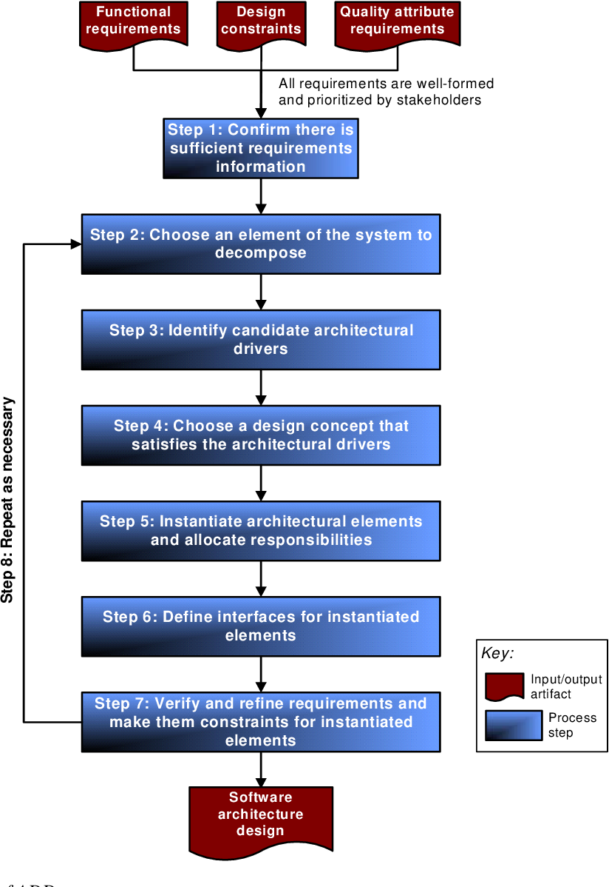
Exercise Goal
Attribute-Driven Design (ADD)
We will practice addressing quality attribute (QA) issues at the software architectural level.
In brief, ADD runs iteratively:
Choose an element to decompose
Identify QAs to be met by the element
Choose and evaluate a design concept to address the QAs of the element
Apply the design concept to the element possibly by decomposing the elements into sub-elements

Slide 3
Context of the Case Study
You are a Software Architect who will design the software architecture for an important Big Data system.
The company is an Internet company that provides popular content to millions of web users.
The system should collect and analyze a massive amount of semi-structured data from hundreds of servers.
The system’s stakeholders include Operations Team, Data Scientists, and Management.
Acknowledgement: The latest materials are originally available https://smartdecisionsgame.com/ . We use an earlier version publicly available in GitHub.

Slide 4
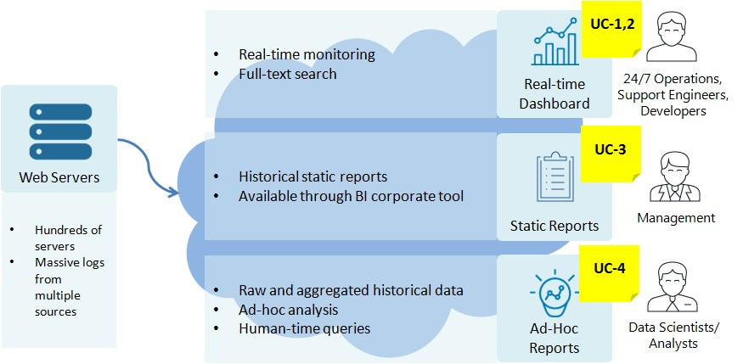
Background: Use Cases

Slide 5
Background: Use Cases
Use case name | Description
UC­1: Monitor online services | On­-duty Operations Team can monitor the actual state of services and IT infrastructure (such as web server load, user activity, and errors) through a real-time operational dashboard to react on potential issues as soon as possible
UC­2: Troubleshoot online service issues | The Operations Team (including Support Engineers and Developers) can do troubleshooting and root cause analysis on the latest collected logs by searching the log patterns and filtering messages
UC­3: Provide management reports | Managers, including Product and IT Managers, can see historical information through predefined (static) reports in a corporate Business Intelligent tool, such as system load in time, features usage, SLA violations and quality of releases
UC­4: Provide ad ­hoc data analytics | Data Scientists and Analysts can do ad­ hoc data analysis through SQL-­like queries to find out specific data patterns and correlations to improve infrastructure capacity planning and customer satisfaction

Slide 6
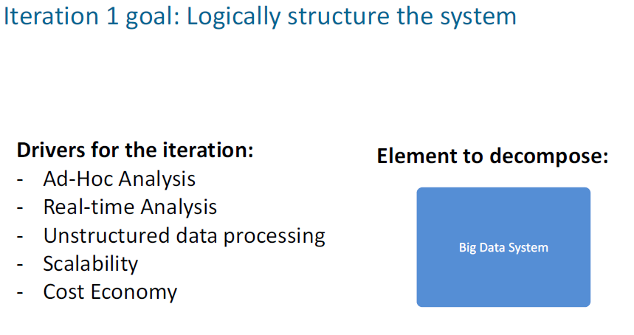
ADD Iteration 1
Aim: Decompose the system into an overall system architecture
Find architecture candidates (e.g., via buy-in expertise)
Identify Quality Attributes (QAs) as Driver
Many servers and many users => scalability
Nature of big data system => unstructured data processing
Nature of use cases: ad-hoc analysis, real-time analysis
Constraint: use open-source tools for cost-saving
Evaluate the choices against the QAs
Form a working group of experts and stakeholders
score each quality attribute by individuals
sum and compare scores (and don’t ignore specific stakeholders’ interests)

Slide 7
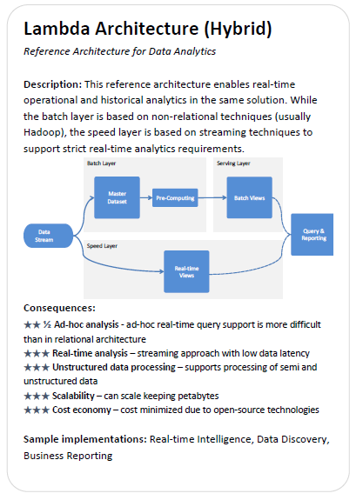
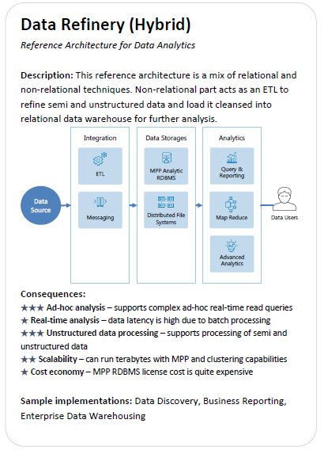
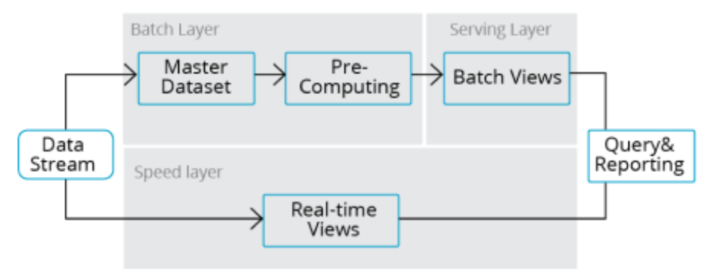
Evaluate the architecture candidates
Two reference architectures on this slide. And two others on the next slide.
Ad hoc analysis:
Real-time analysis:
Unstructured data processing:
Scalability:
Cost economy:
Ad hoc analysis:
Real-time analysis:
Unstructured data processing:
Scalability:
Cost economy:
(score 1 to 5)
(score 1 to 5)

Slide 8
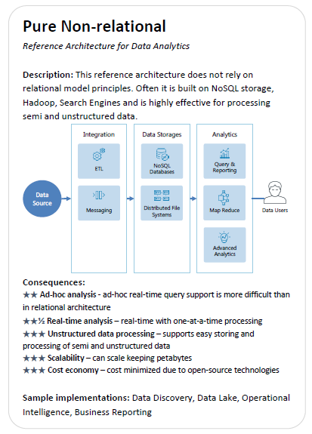
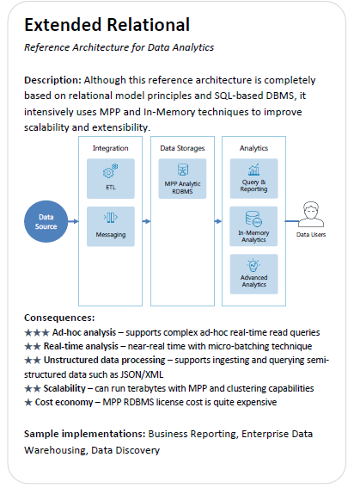
Evaluate the architecture candidates
Ad hoc analysis:
Real-time analysis:
Unstructured data processing:
Scalability:
Cost economy:
Ad hoc analysis:
Real-time analysis:
Unstructured data processing:
Scalability:
Cost economy:
(score 1 to 5)
(score 1 to 5)

Slide 9
Comparison (1/2)
Two reference architectures on this slide. And two others on the next slide.
(score 1 to 5)

Slide 10
Comparison (2/2)

Slide 11
Chosen Candidate for Iteration 1
Lambda Architecture is the best option (highest star points + balance)
If unbalanced, some stakeholders may not be happy
14.5 stars
10 stars
10 stars
13.5 stars

Slide 12
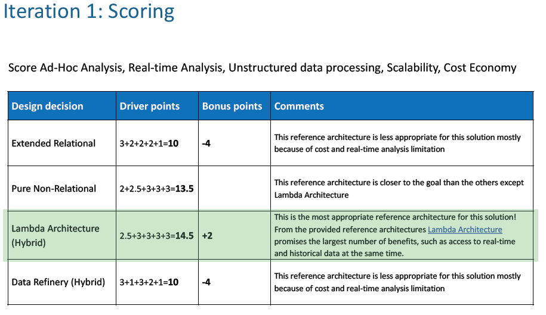

Slide 13
Score Card for the Case Study
 | Iteration |  |  |  |  | Total Score
 | 1 | 2 | 3 | 4 | 5
Design Decision (Names of selected design concept(s)) | Lambda Architecture
(b) Driver Selection Points (from Cards) | 14.5
(c) Analysis bonus points (from review to be released after all 5 iterations) | 2
(d) Iteration total = (a) + (b) + (c) | 16.5
Fill other cells when you perform Iterations 2-5

Slide 14
More Iterations on ADD
We now want to design each element in the adopted architecture.
Let’s work on the following four elements in iterations 2 to 5. In general, we will have more iterations in practice.
Iteration 1: Decompose the system into an overall system architecture
Iteration 2: Design the data stream
Iteration 3: Design the Batch Layer
Iteration 4: Design the Serving Layer
Iteration 5: Design the Speed Layer
We need to look at the QAs for each iteration (see next slide).

Slide 15
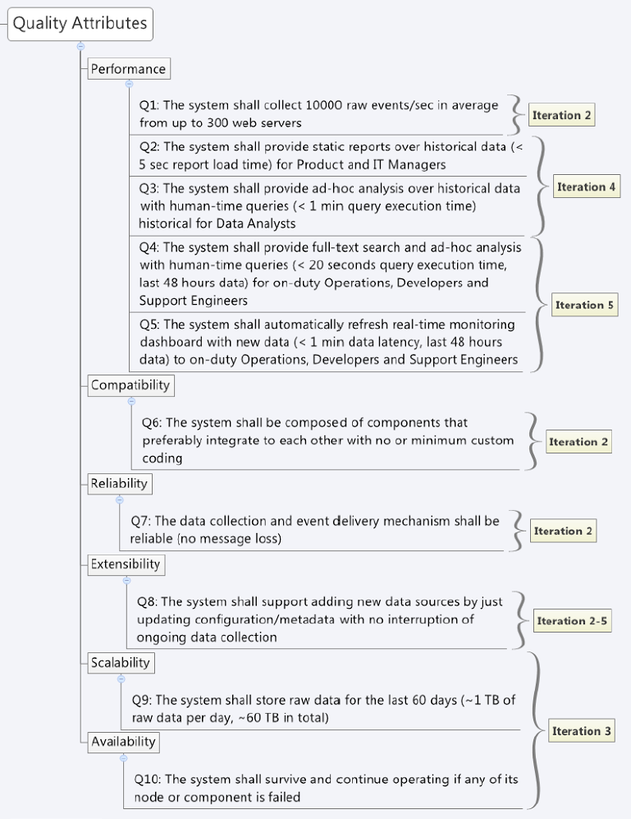
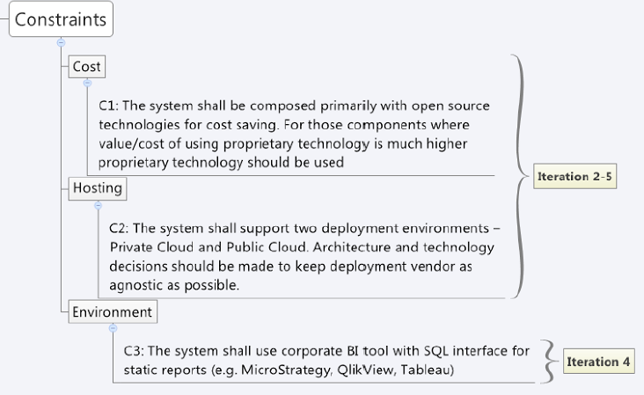
Non-Functional Requirements (QAs)
Here is a list of non-functional requirements elicited by the requirement analyst. In practice, designers should label which iterations to address them.

Slide 16
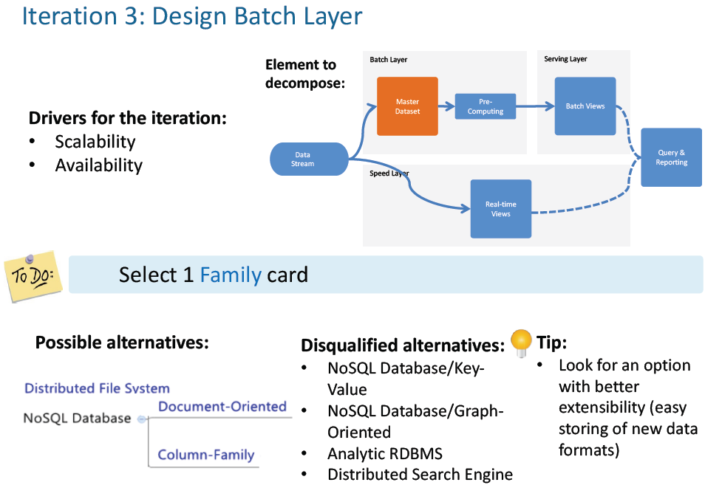
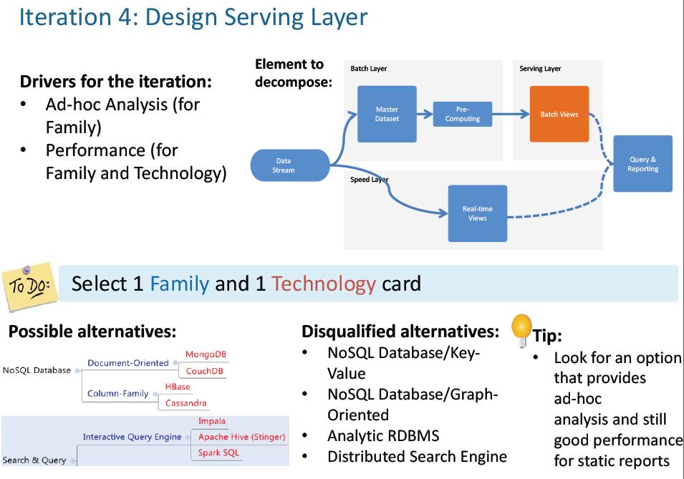
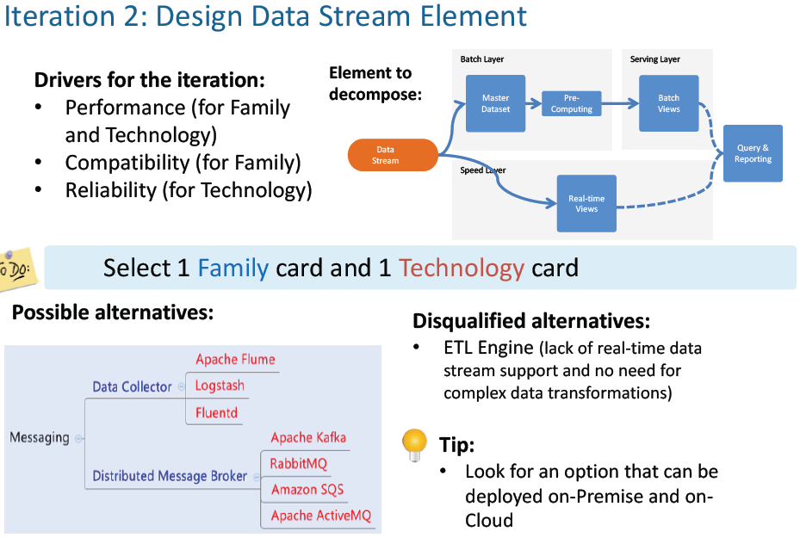
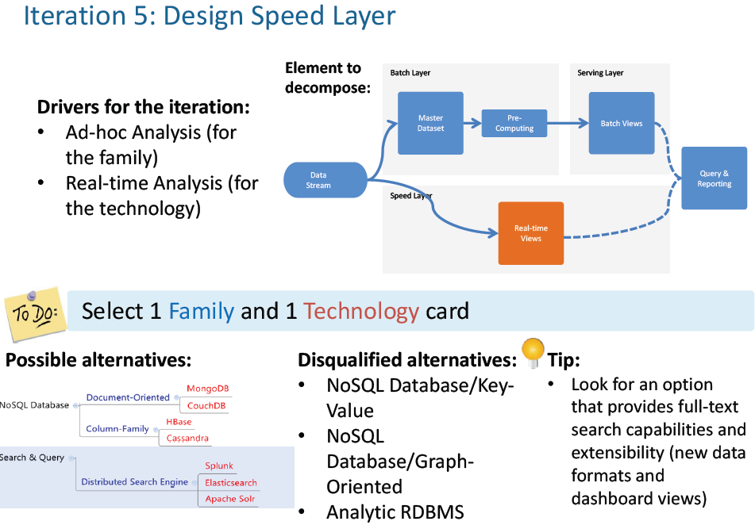
Goals of the Five Iterations

Slide 17
ADD Iteration 2
We choose a family of technology to address Performance and Compatibility concerns and then a specific technology under the selected family to address Performance and Reliability issues for Data Stream
Note that only the QAs we care about should be counted in evaluating the suitability.

Slide 18
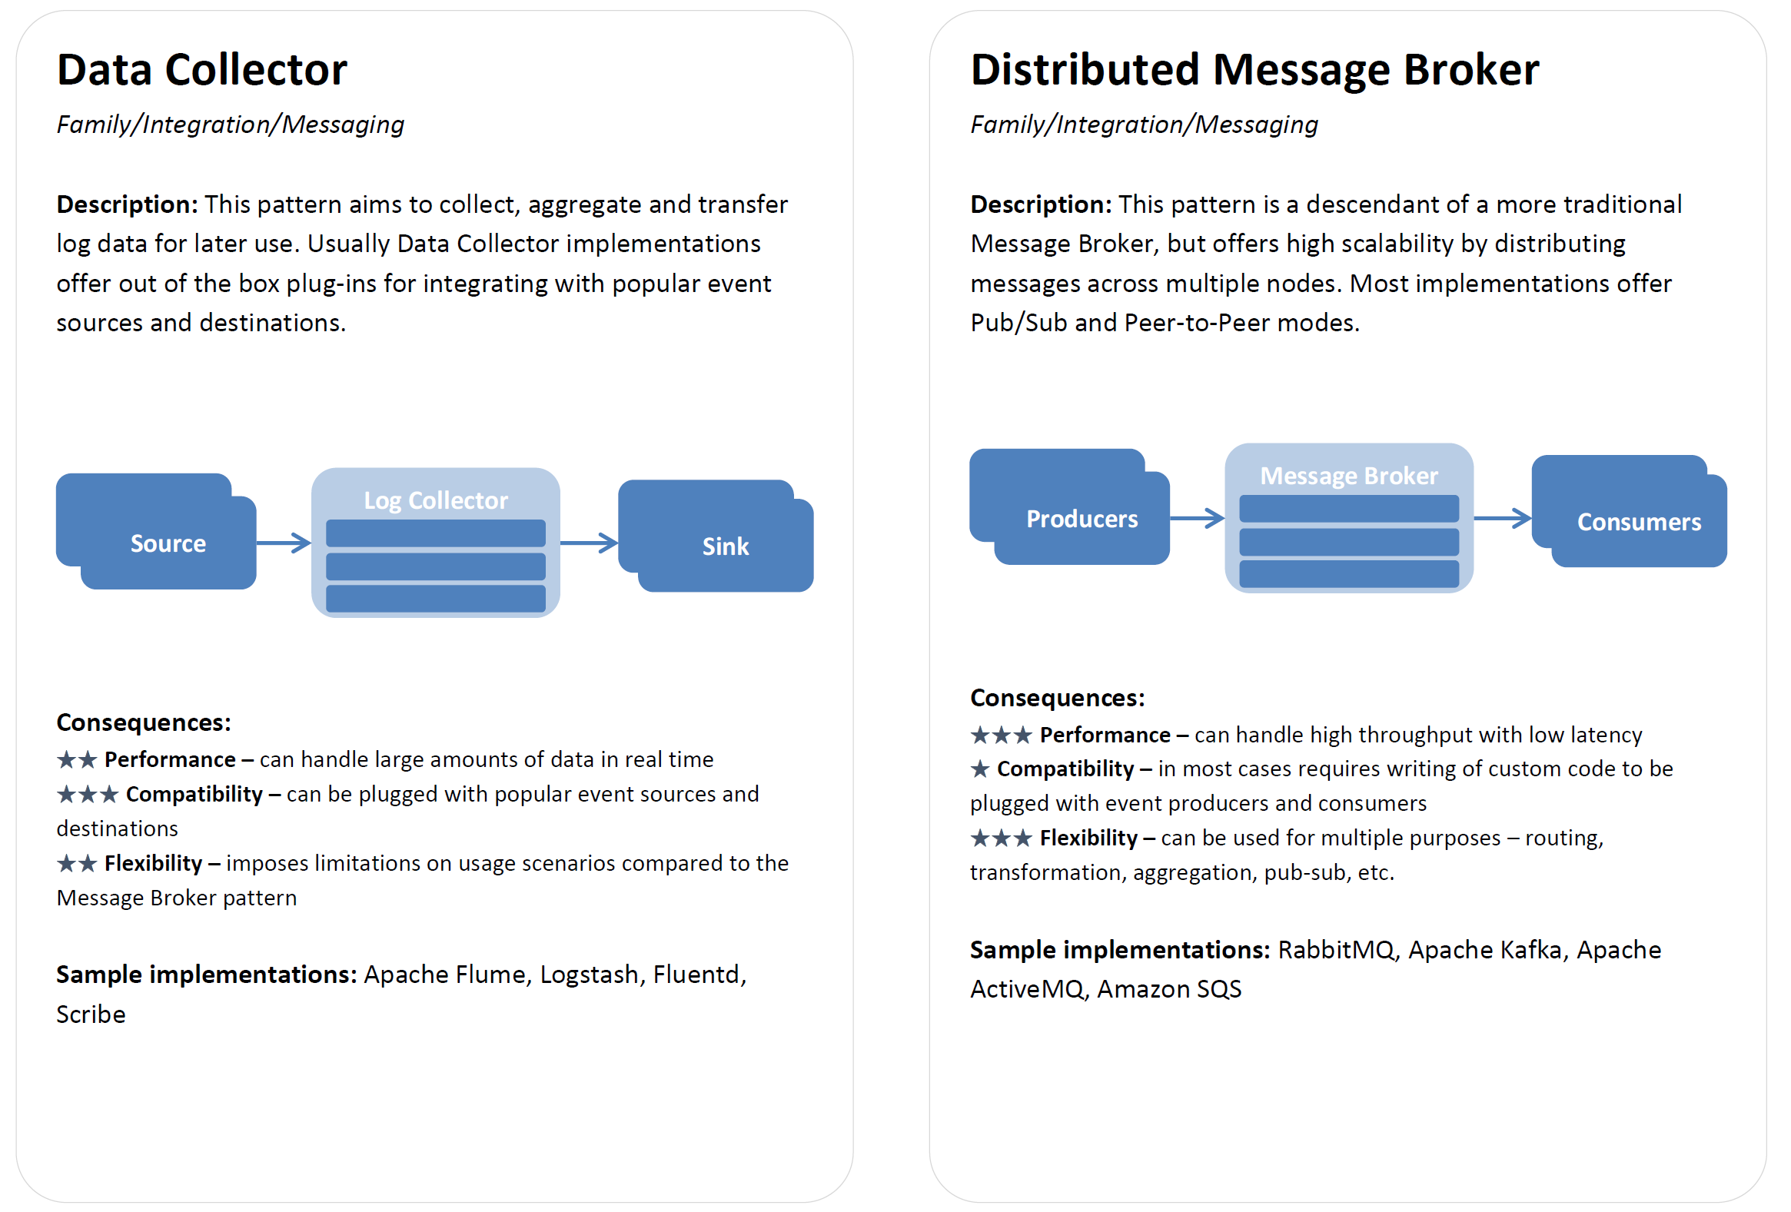
Family of Technology for Iteration 2
The Family of technology for the integration of components via Messaging
To Do:
Evaluate and choose one
Note that Flexibility is not the QA we care about in Iteration 2

Slide 19
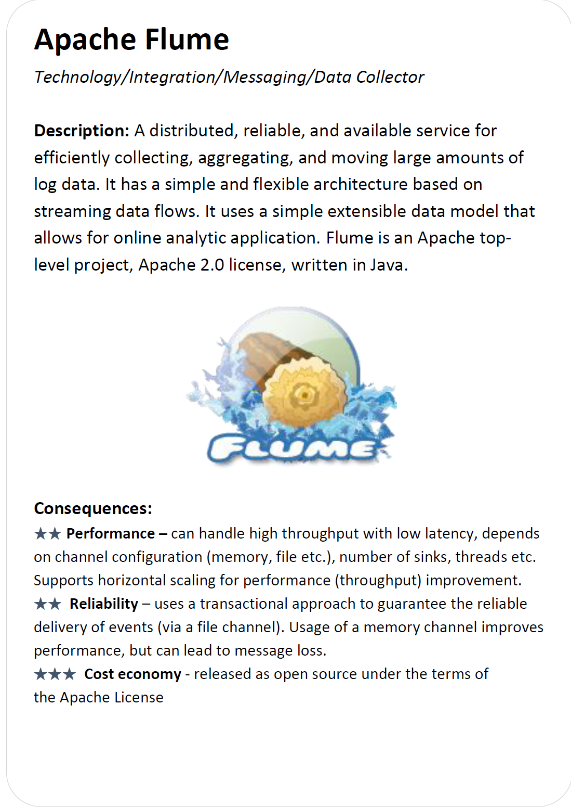
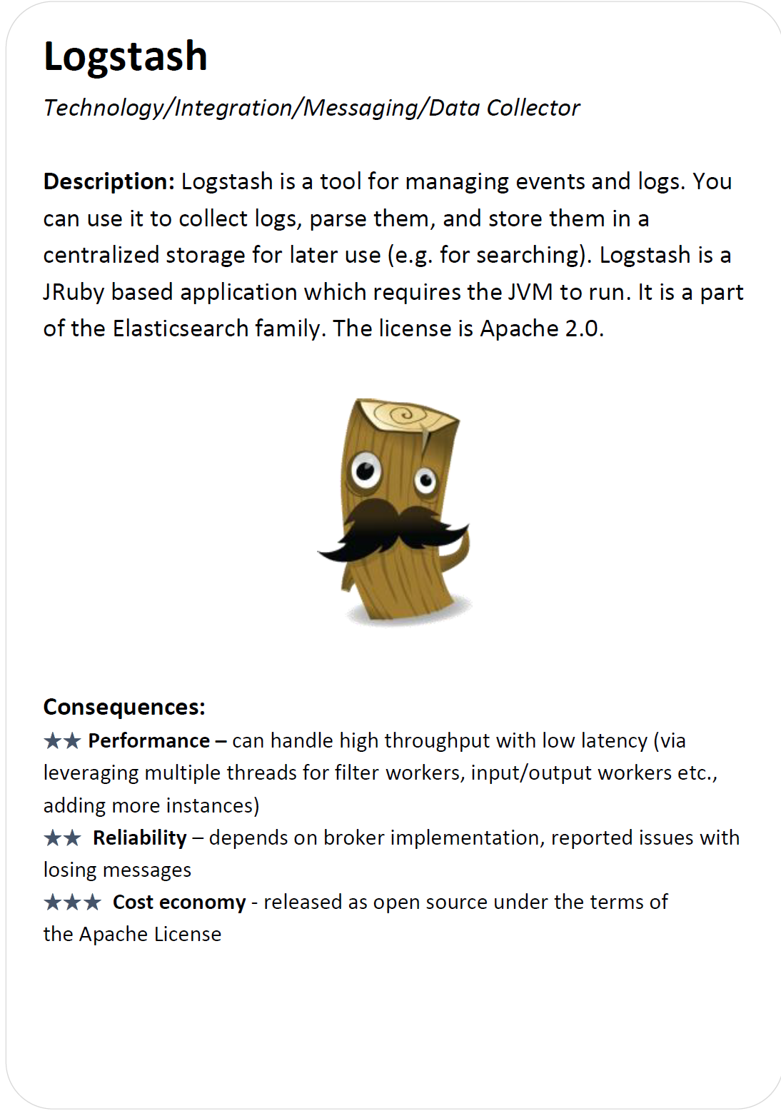
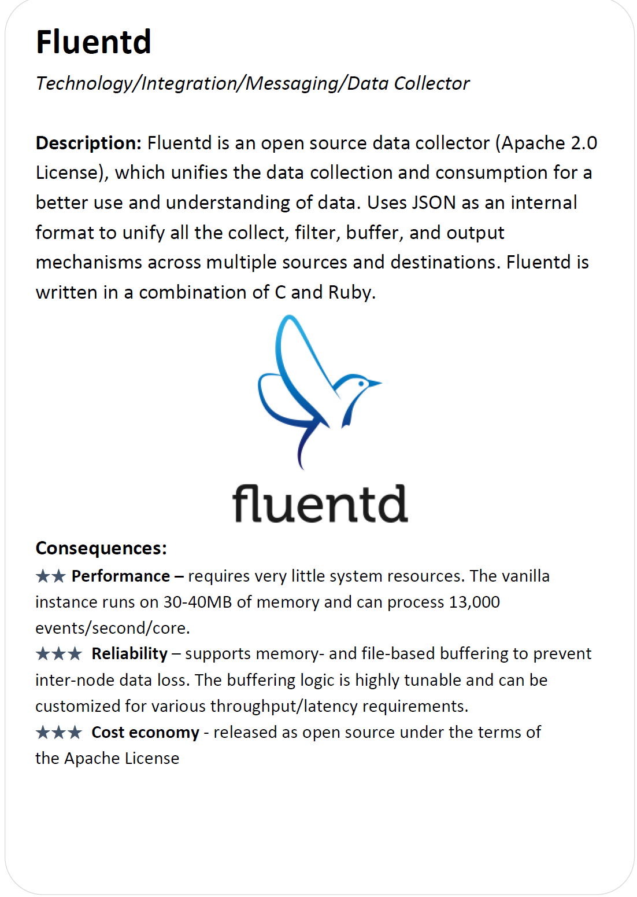
3 Technology Choices under Data Collector Family
To Do: Evaluate and choose one if you use this Family

Slide 20

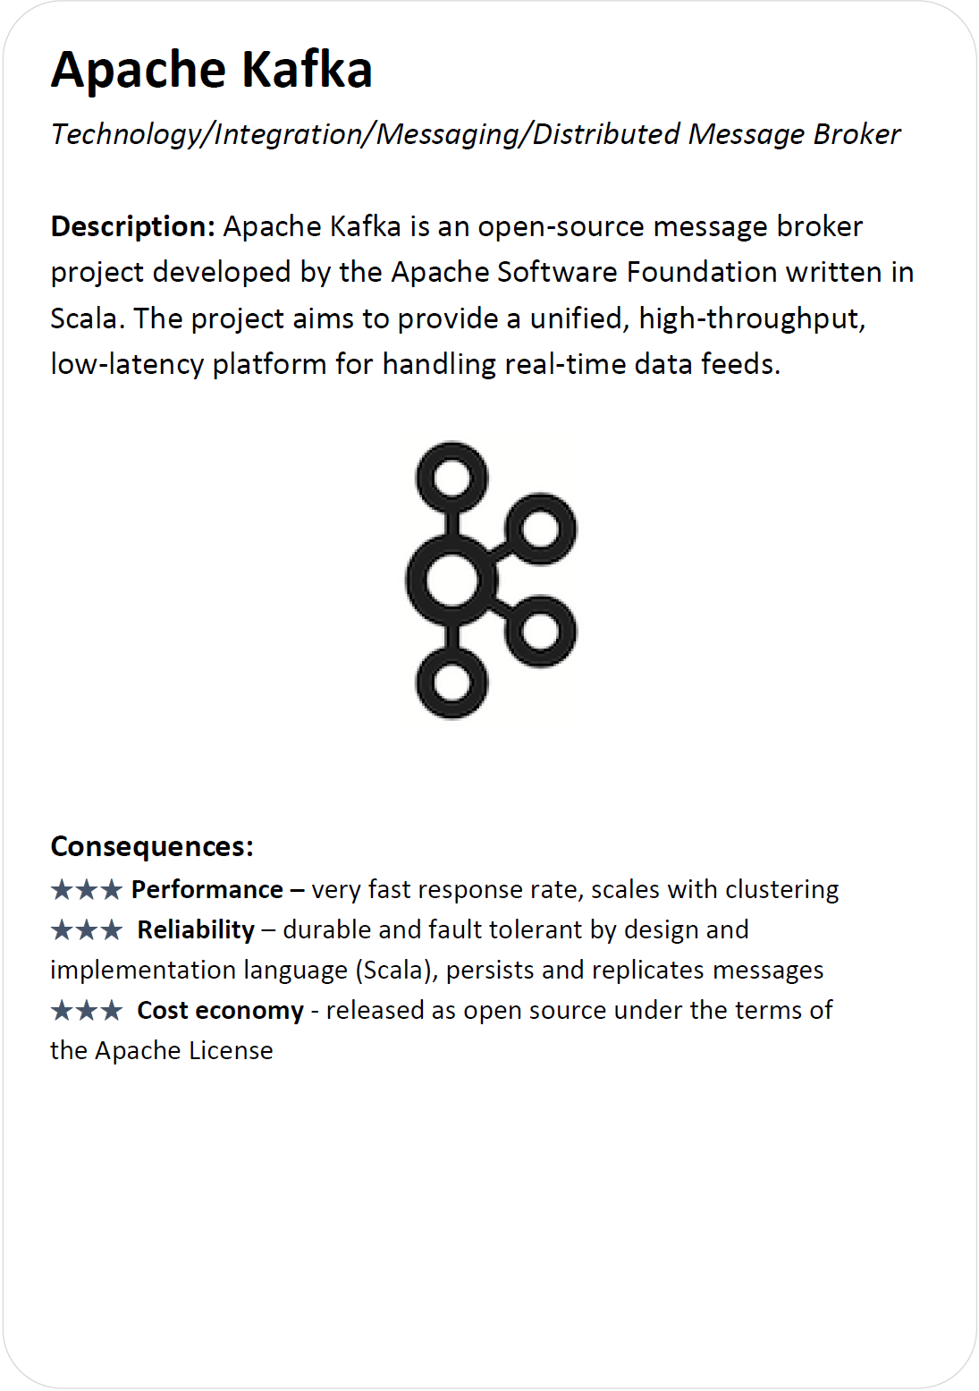
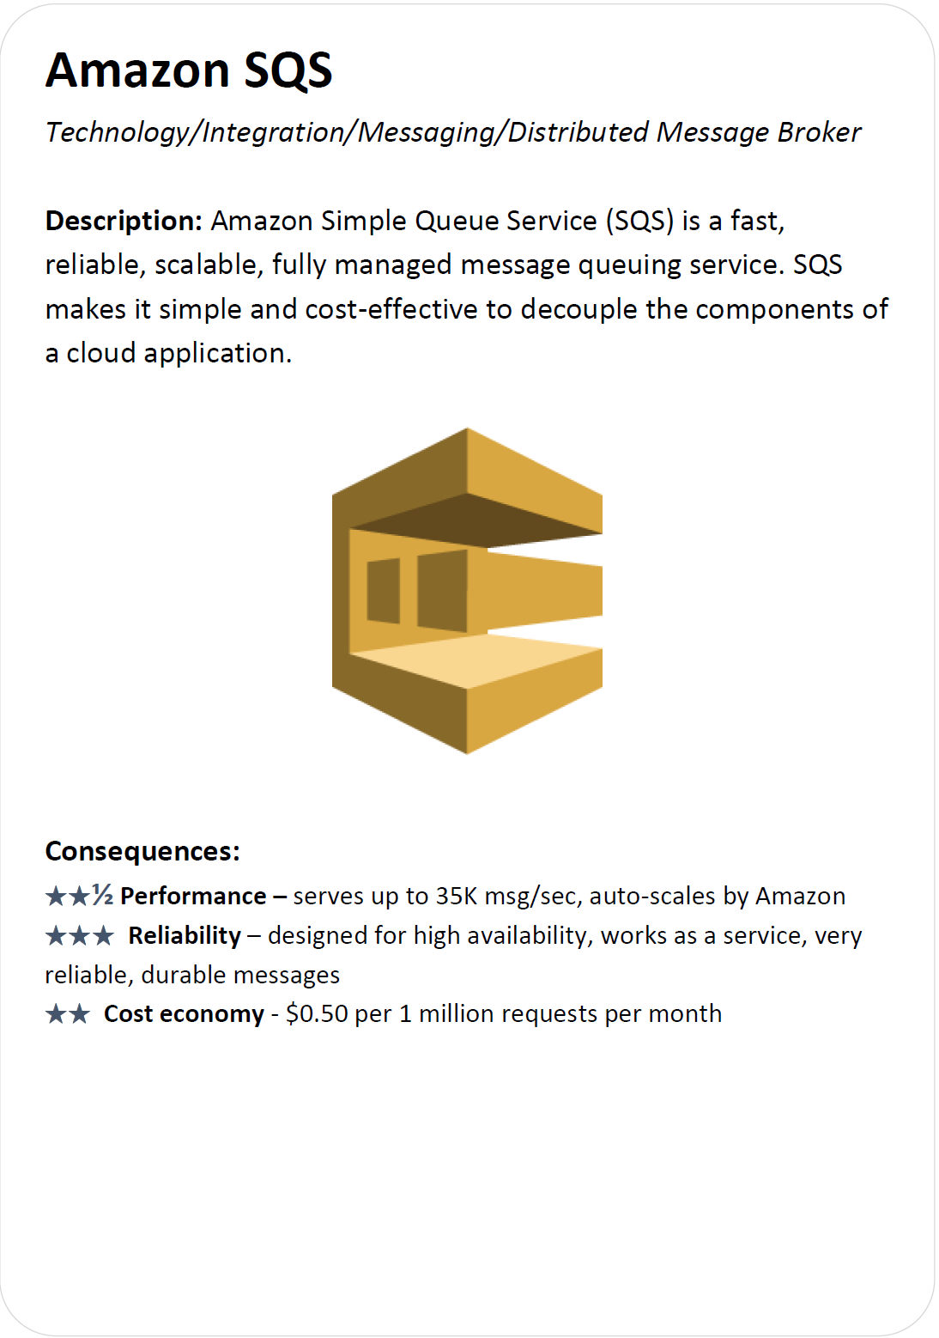
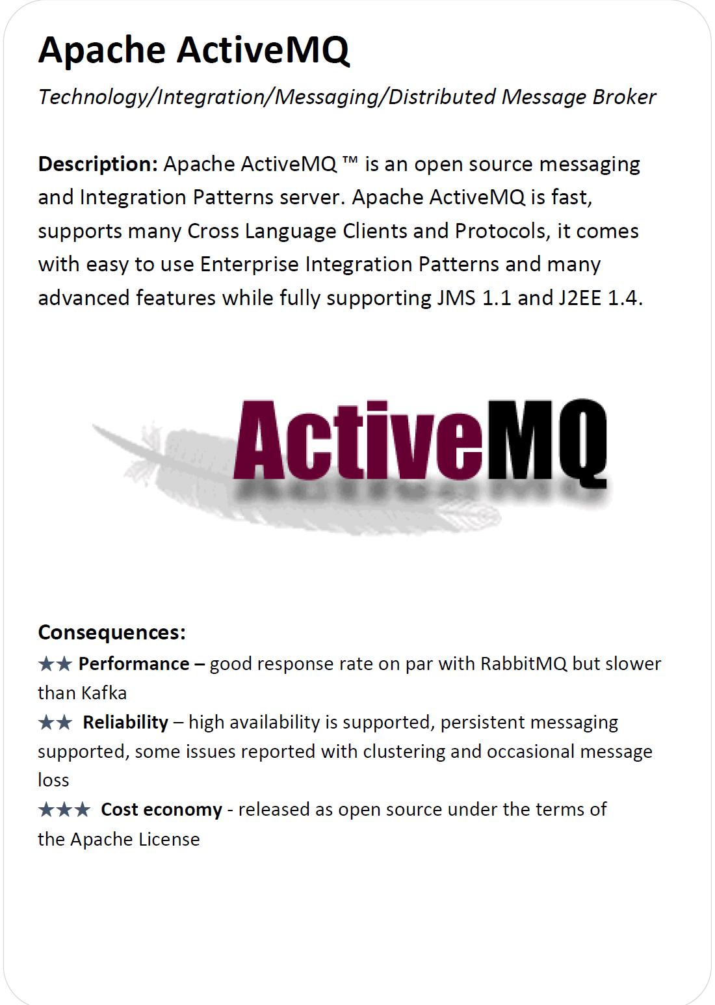
Technology Choices under Distributed Message Broker Family
To Do: Evaluate and choose one if you use this Family

Slide 21
ADD Iteration 3
Goal: Address the Scalability and Availability concerns in Batch Layer
Like Iteration 2, we research the Family candidates, evaluate their suitability, and select the best one.

Slide 22
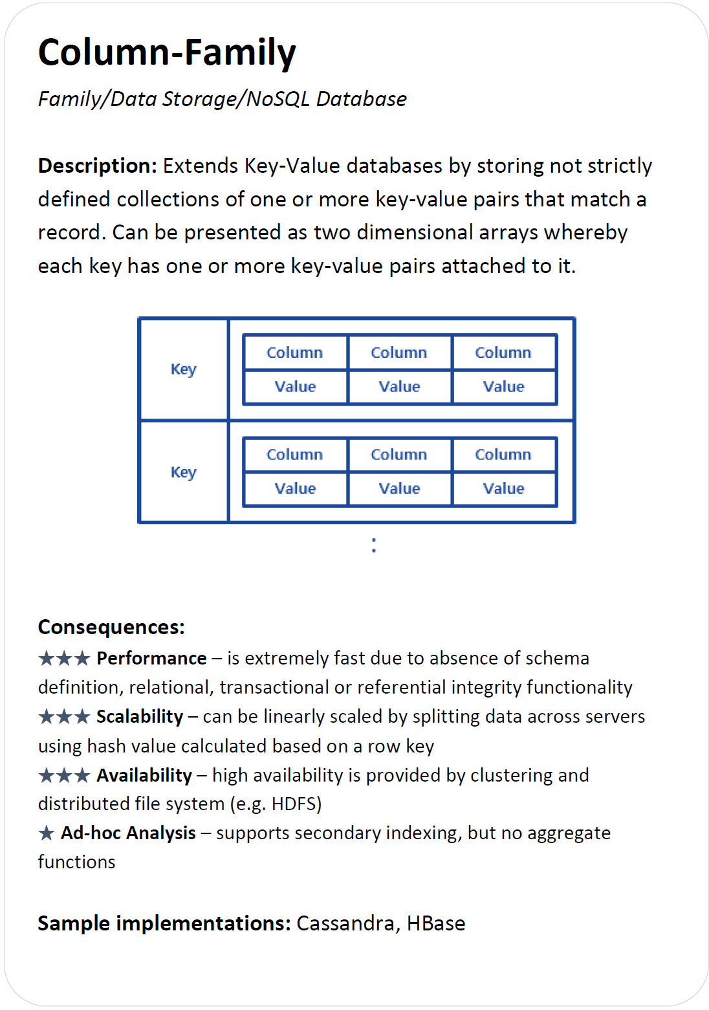
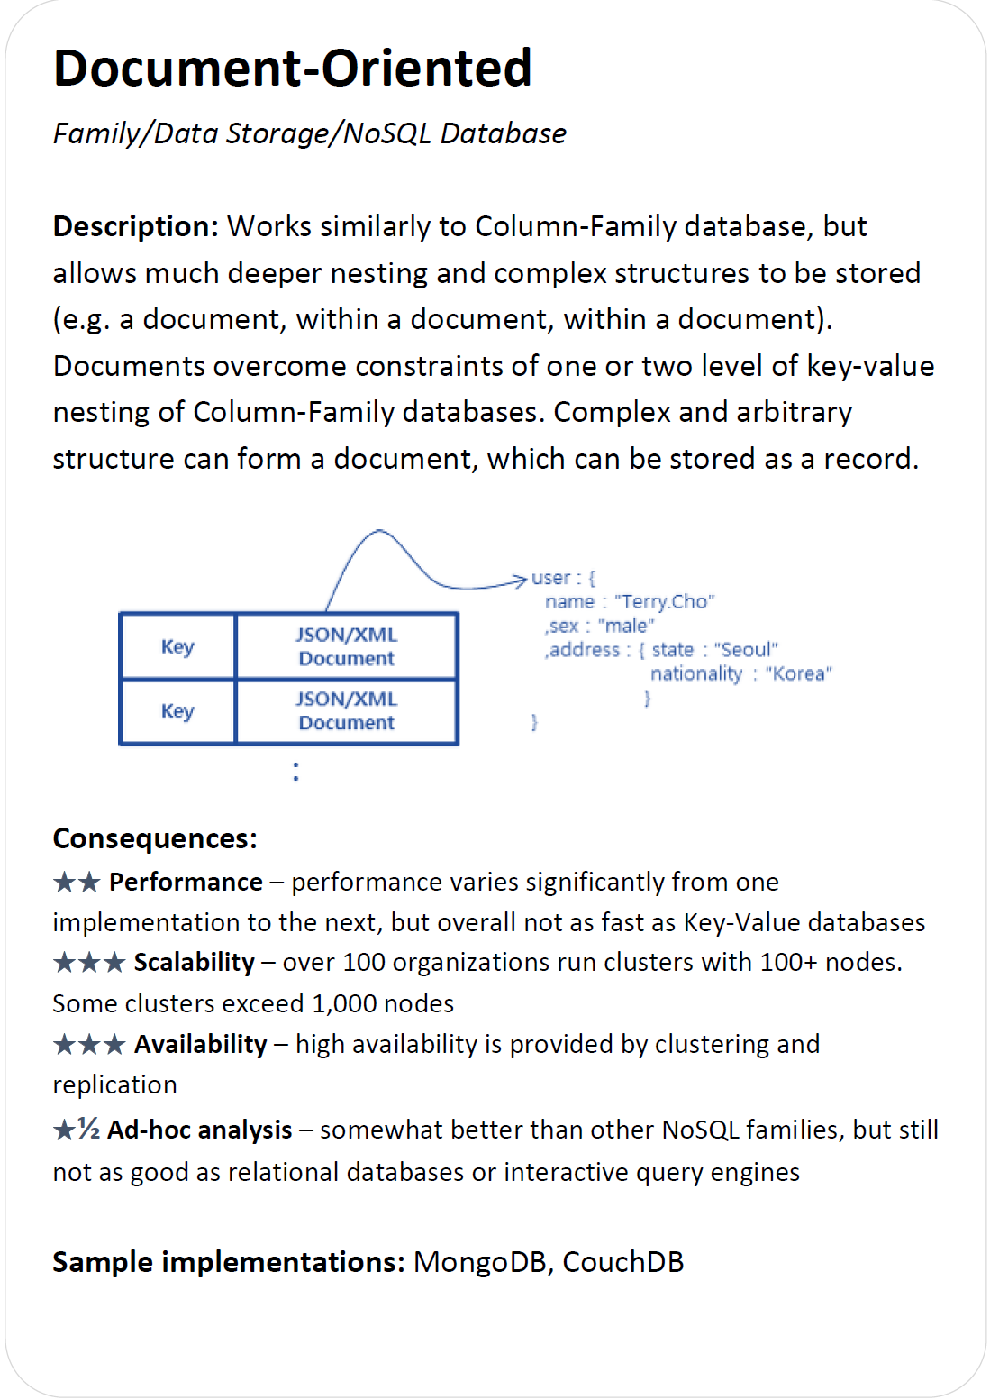
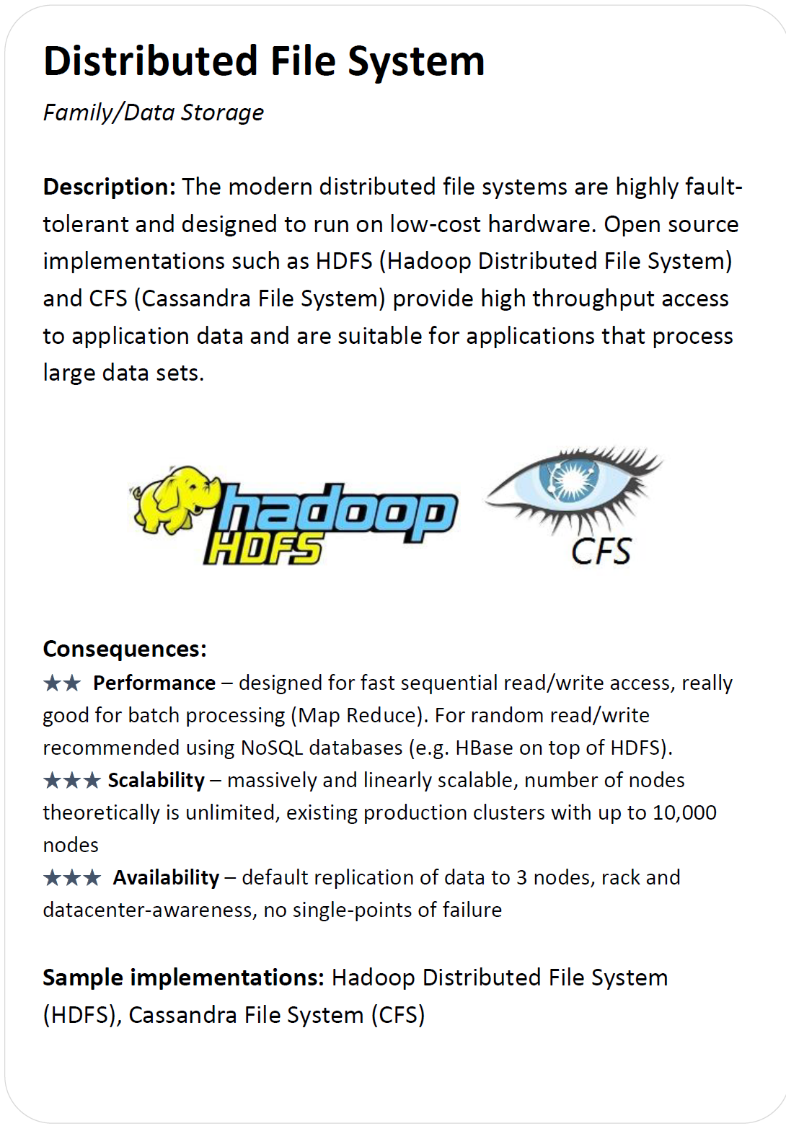
3 Families of Technology for Iteration 3
To Do: Evaluate and choose one

Slide 23
ADD Iteration 4
Goal: We address the need for Ad-hoc analysis and Performance concerns in this iteration in Serving Layer

Slide 24
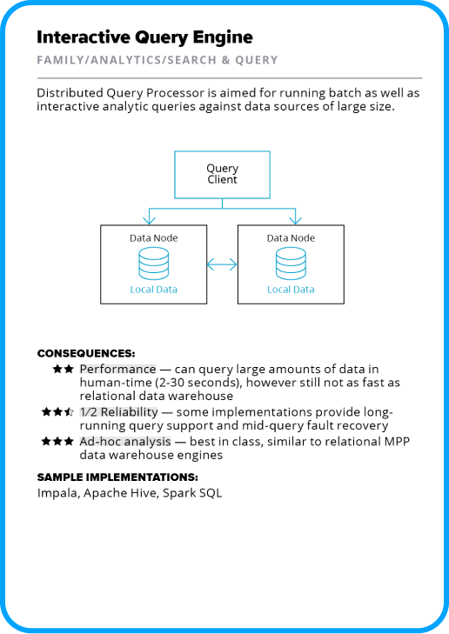
3 Families of Technology for Iteration 4
To Do: Evaluate and choose one

Slide 25
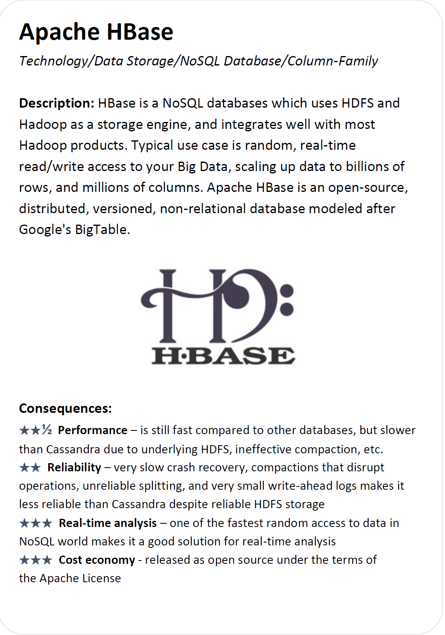
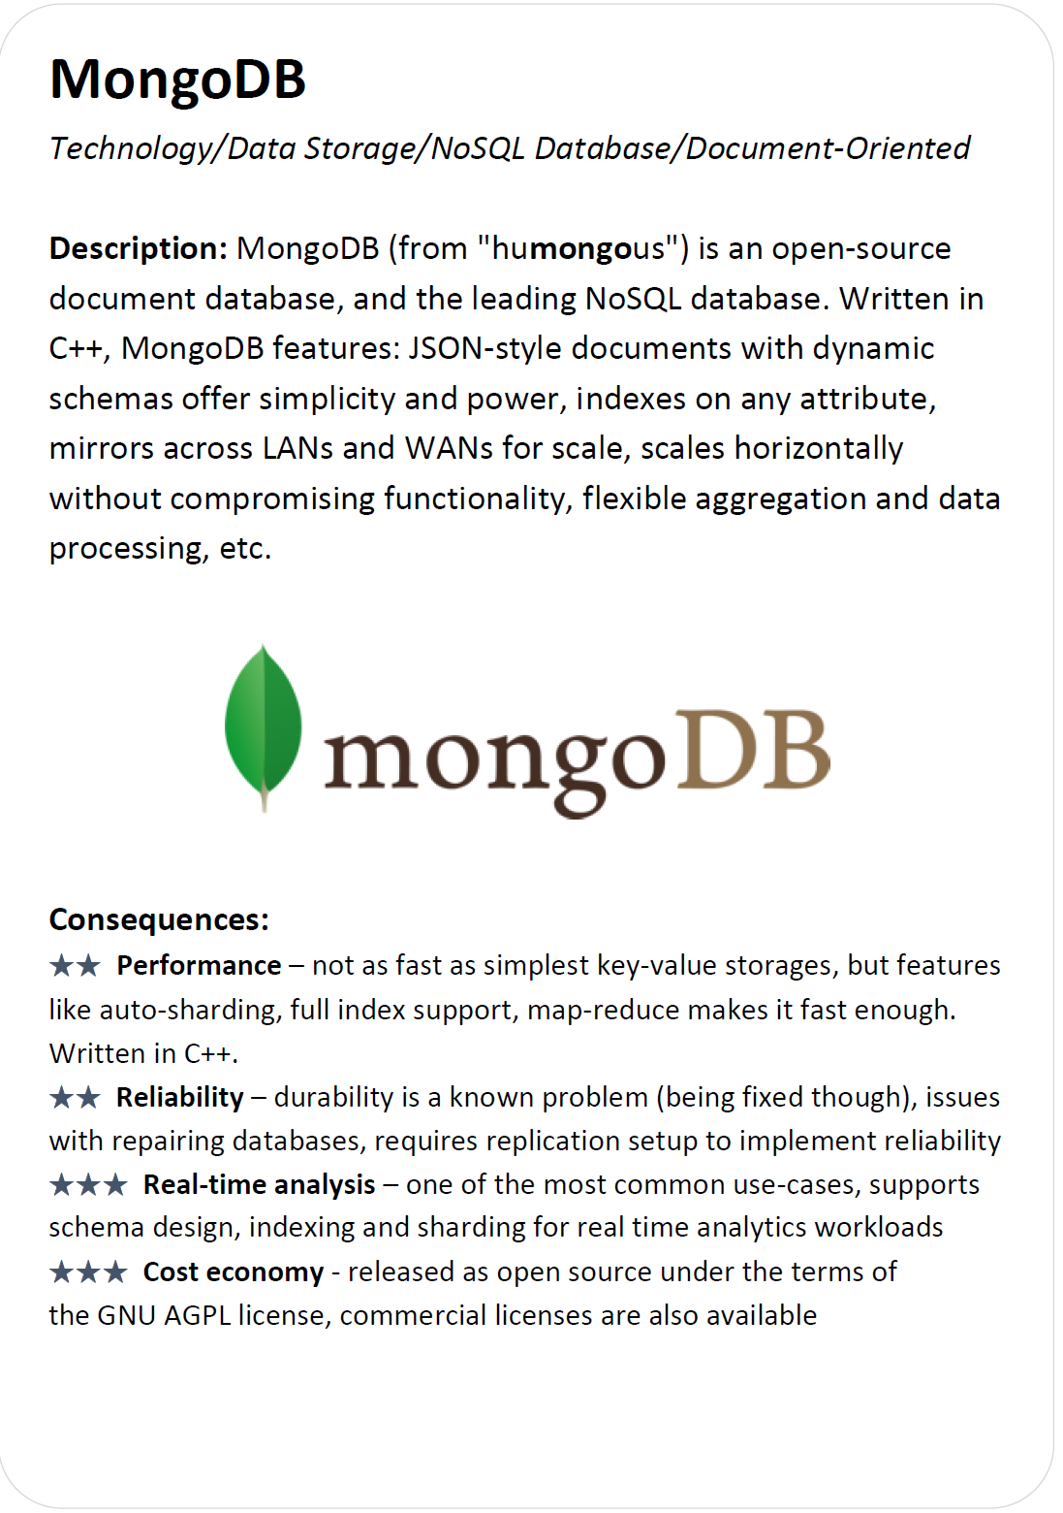
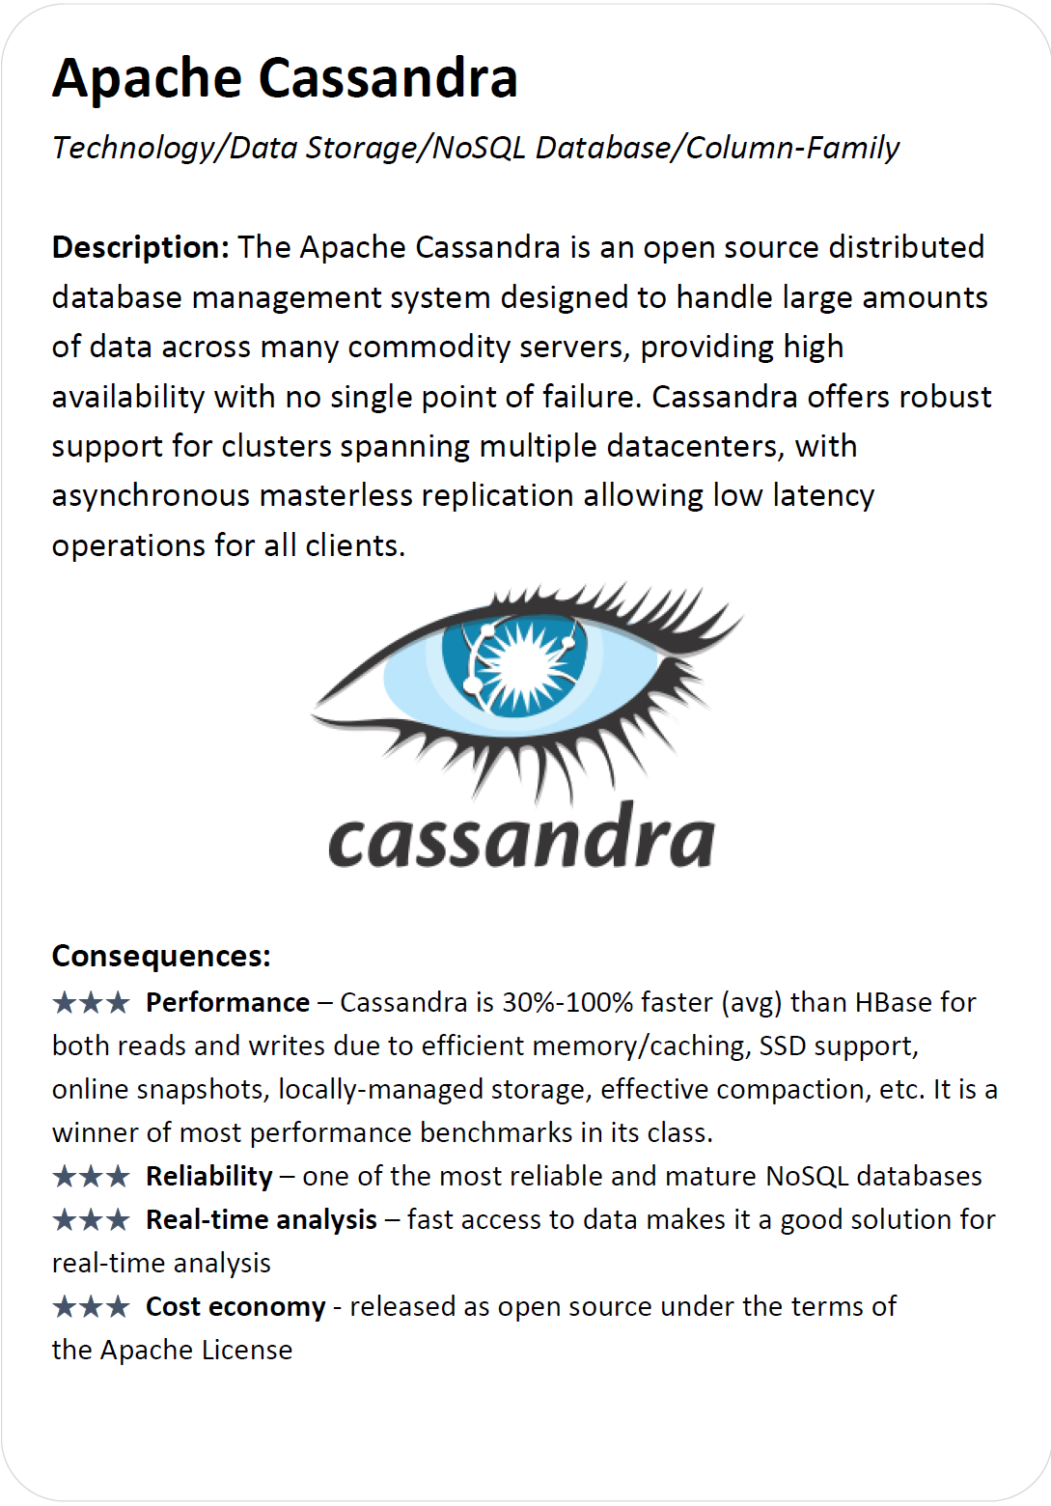
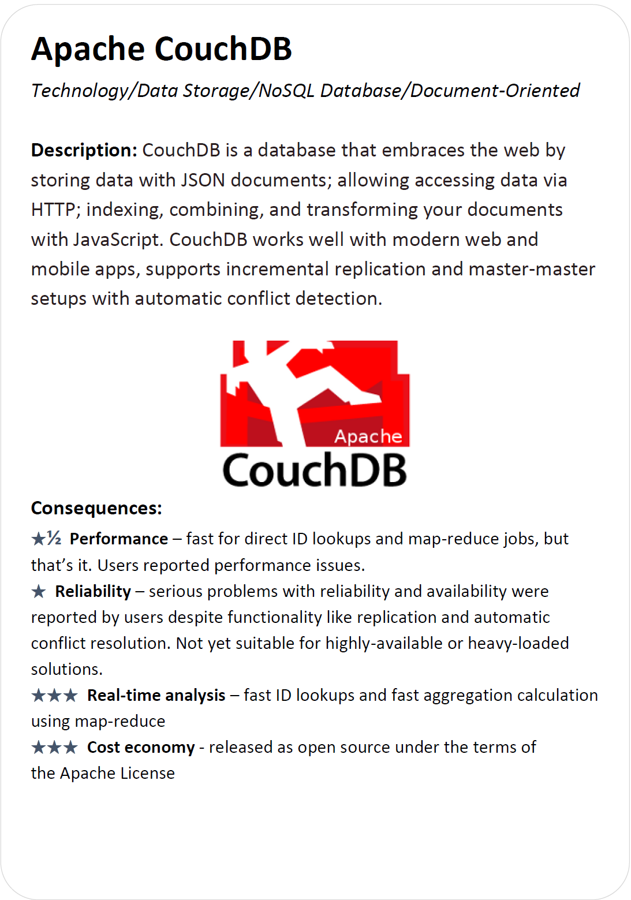
7 Technology Choices for Iteration 4
To Do: Evaluate and choose one among the technologies in this and the next slides
Note that these four technologies are only applicable to NoSQL family

Slide 26
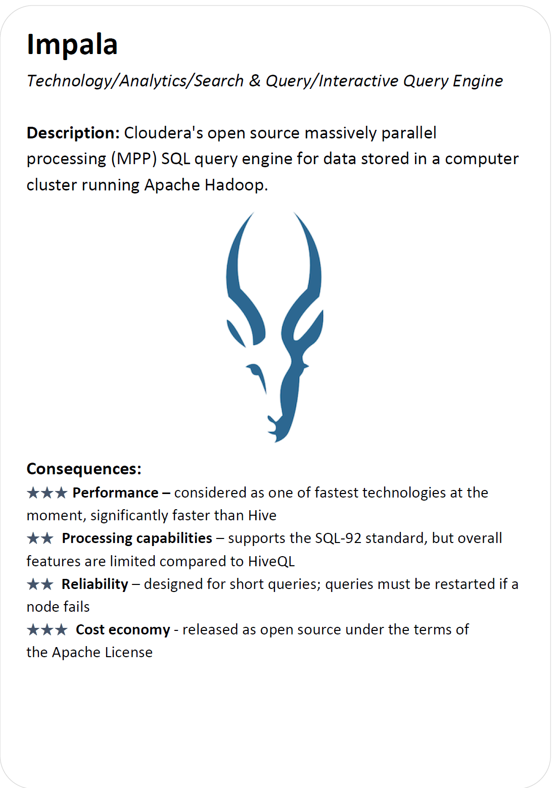

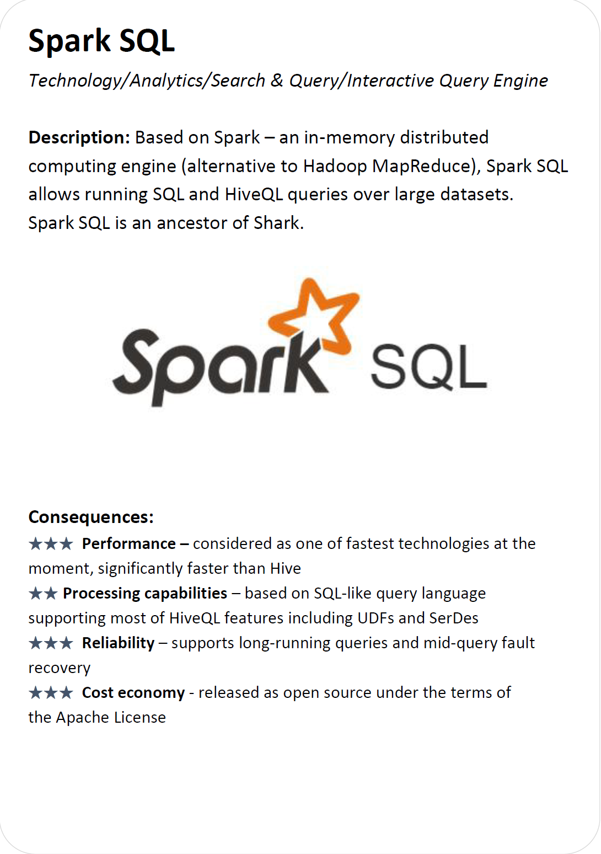
7 Technology Choices for Iteration 4

Slide 27
ADD Iteration 5
Goal: Address the ad hoc analysis and real-time analysis in the Speed Layer at the Family and Technology Levels, respectively.

Slide 28
3 Families of Technology for Iteration 5
To Do: Evaluate and choose one

Slide 29
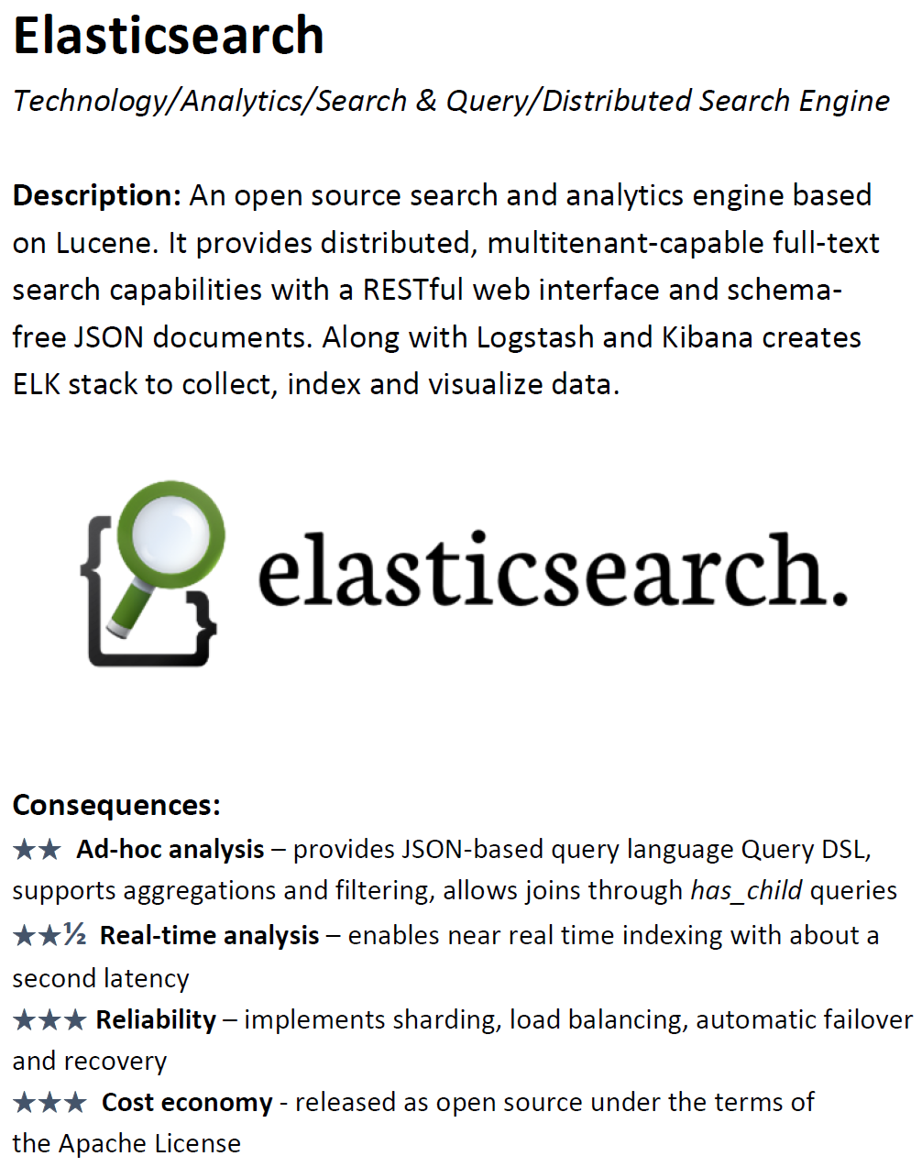
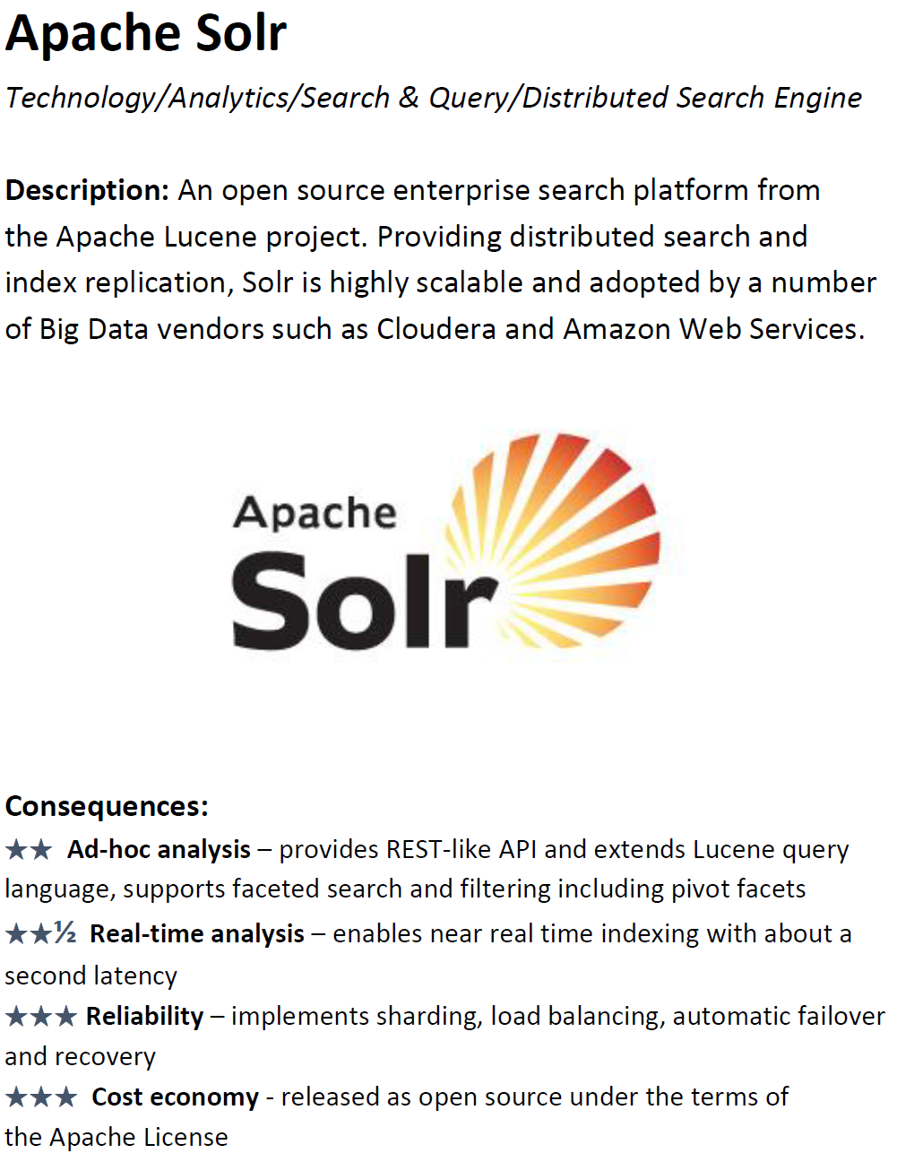
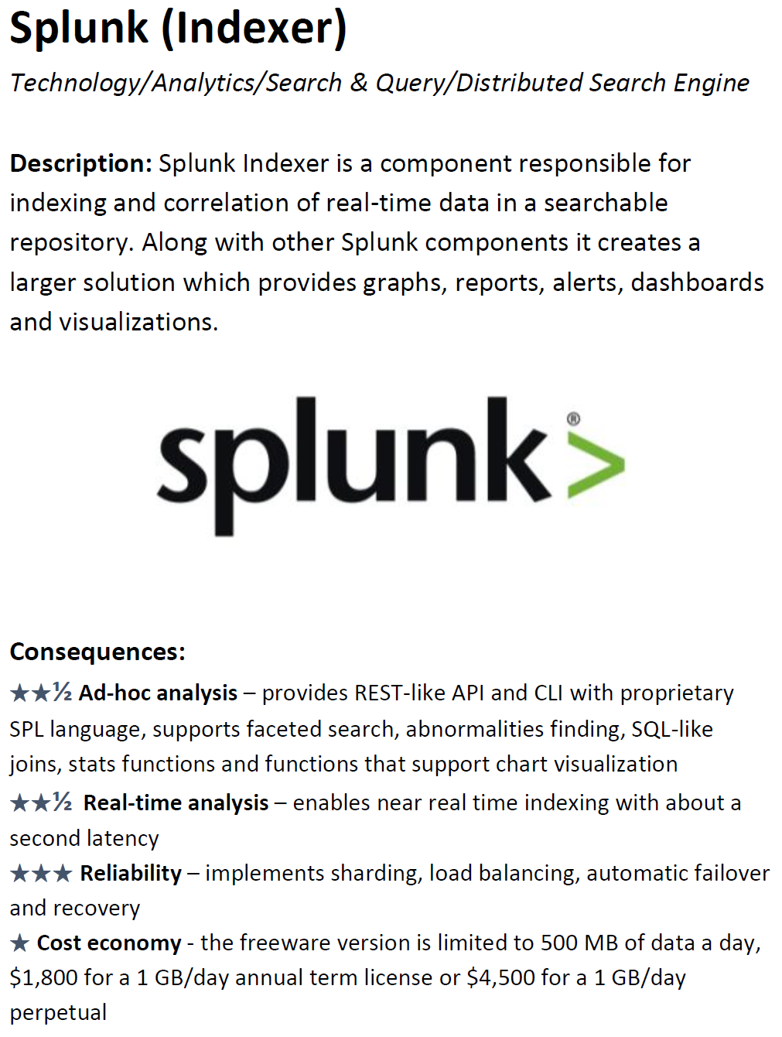
7 Technology Choices for Iteration 5
To Do: Evaluate and choose one among the technologies in this and the next slides

Slide 30
7 Technology Choices for Iteration 5
Note that these four technologies are only applicable to NoSQL family

